Slide 1
Module 9 Junit Tests
Montgomery College
Computer Science Department

Slide 2

My program works!
(I’m not really sure why)

Slide 3
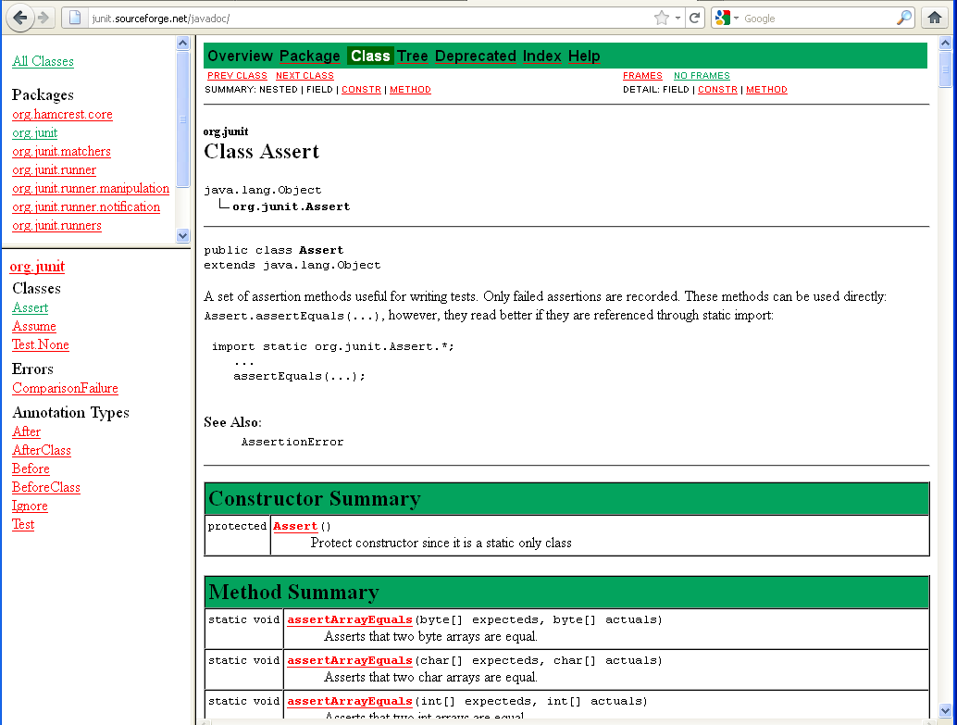
http://junit.sourceforge.net/javadoc/

Slide 4
JUnit provides overloaded assertion methods for all primitive types and Objects and arrays (of primitives or Objects). The parameter order is expected value followed by actual value.
assertEquals(true, “hello”.equals(“hello”);
assertEquals(“hello”, “hello”);
assertEquals(false, “hello”.equals(“goodbye”);
assertTrue(“hello”.equals(“hello”);
assertFalse(“hello”.equals(“goodbye”);
Optionally the first parameter can be a String message that is output on failure.
assertEquals(“failure – strings should be equal”, true, “hello”.equals(“hello”);
assertEquals(“failure – strings should be equal”, “hello”, “hello”);

Slide 5
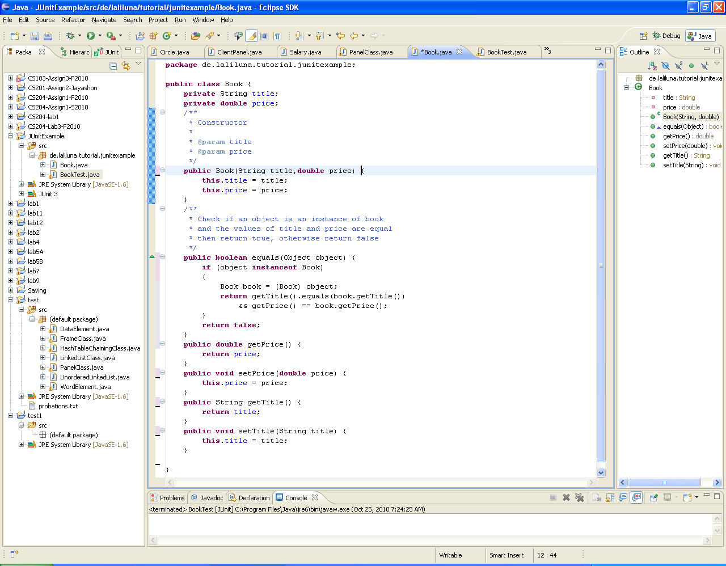
The class Book

Slide 6
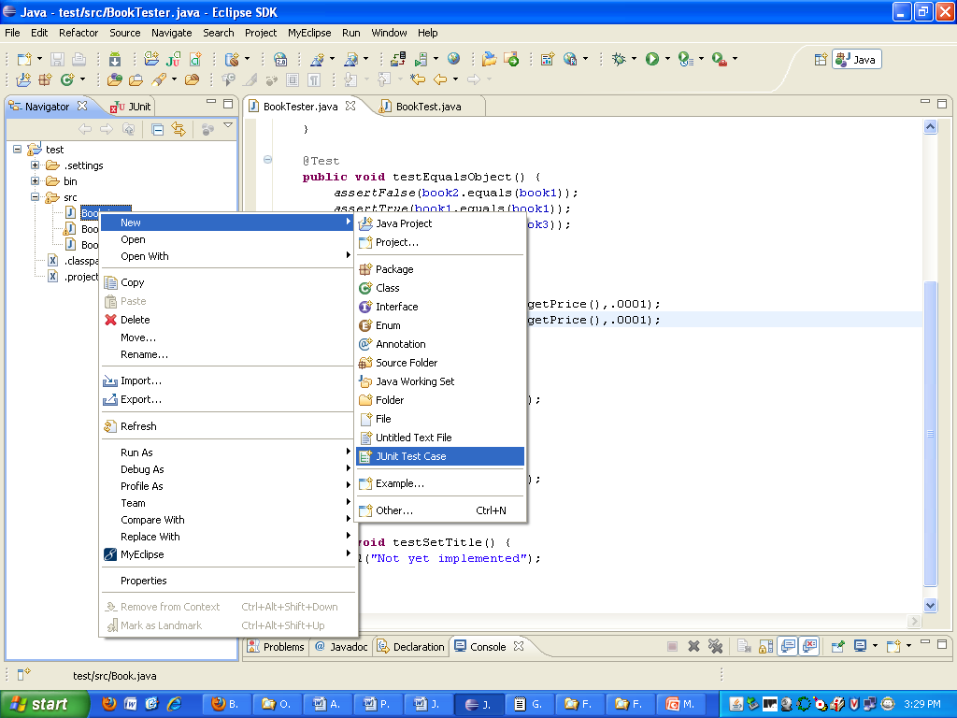
The test case BookTester

Slide 7
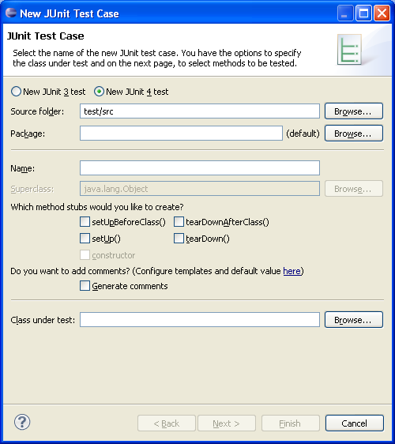

Slide 8
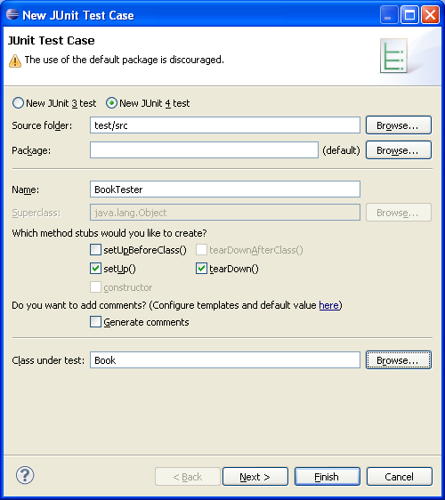
Select Browse for Class under test

Slide 9
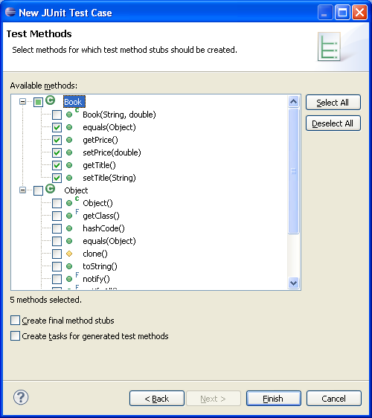
Select all the methods of Book that you want to test.
Then select next

Slide 10
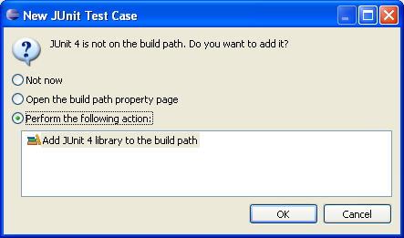
If the Junit 4 is not on the build path, you will get this pop-up
Select OK

Slide 11
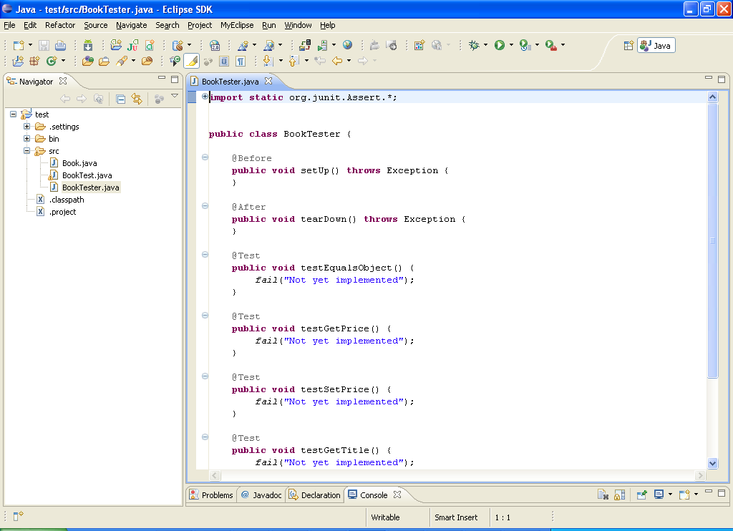
A Junit test class is created, methods are not implemented

Slide 12
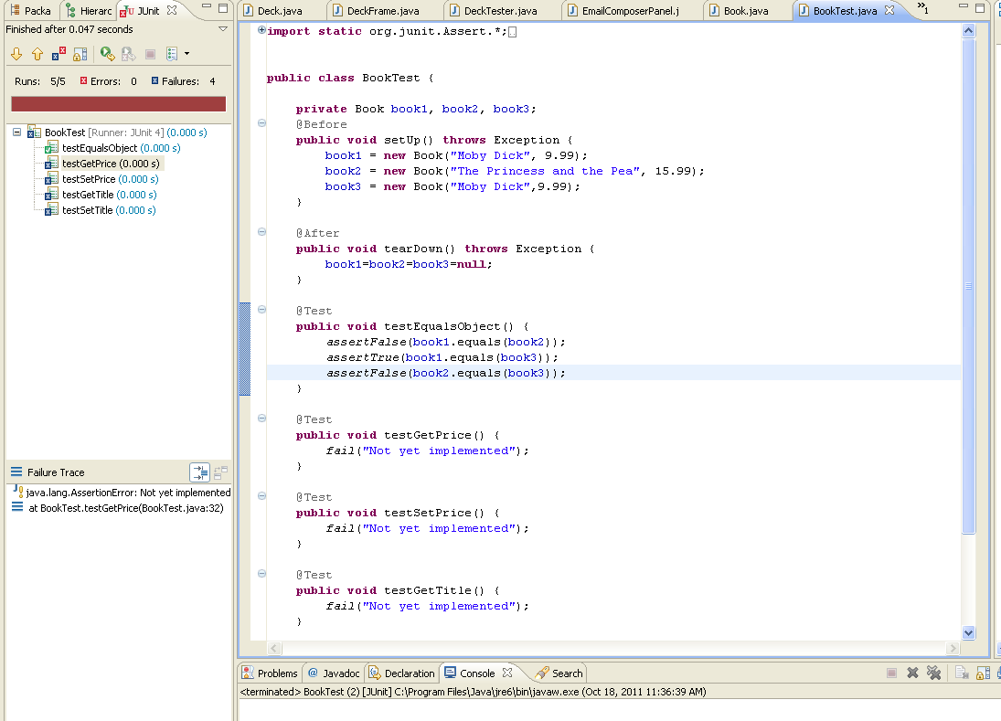
Create instance variables and create objects to test on

Slide 13
Start implementing test

Slide 14
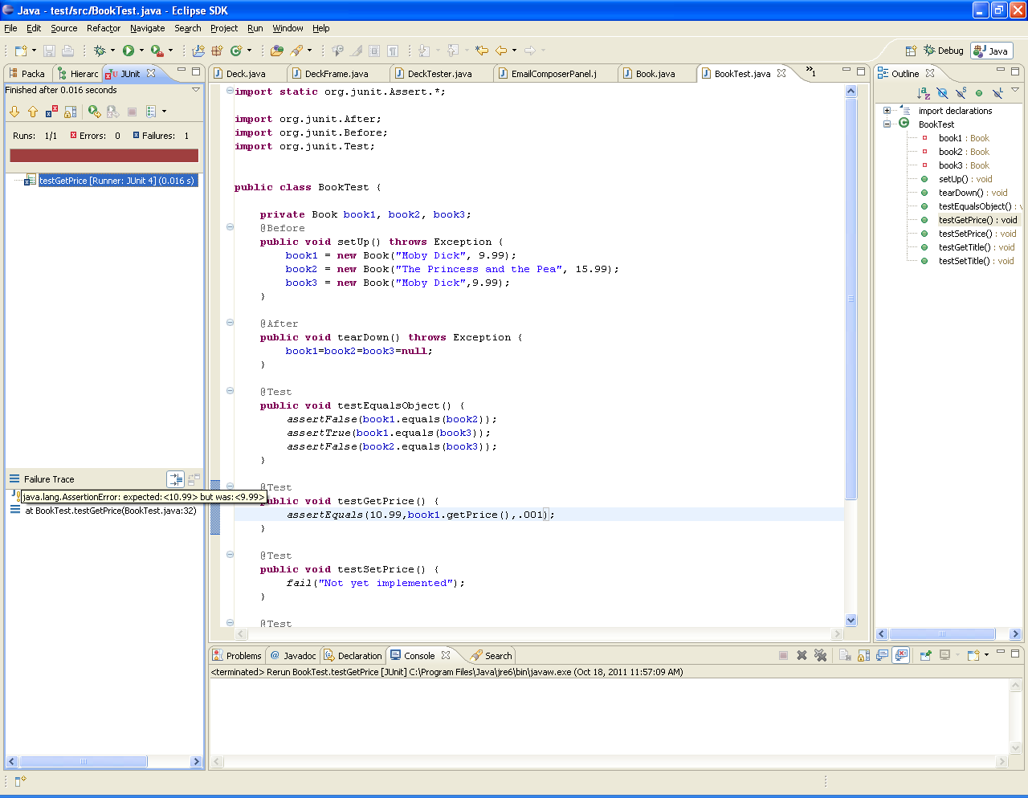
Test fail

Slide 15
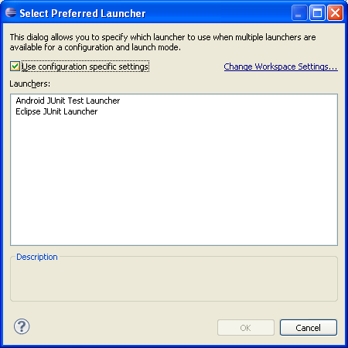
If you see this pop-up, select Eclipse Junit Launcher

Slide 16
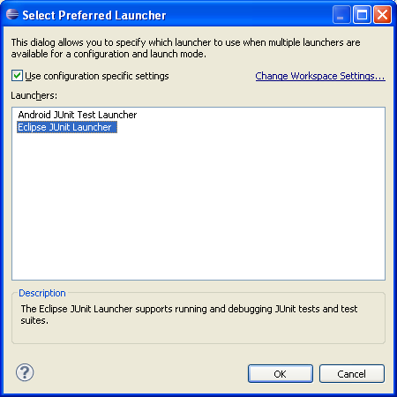
Select OK

Slide 17
Guidelines for JUnit Tests
Your test methods should test the method with at least 2 objects.
Example:
@Test
public void testEquals() {
assertFalse(book1.equals(book2));
assertTrue(book1.equals(book3));
}
If you are using an assertEquals, the first argument is what you expect the
result to be, the second argument is the call to the method
assertEquals(15.99, book2.getPrice(), .001);
If the method changes one of the data members of the object, test what the value of the data member is first, call the method and then test the new value of the data member.
Example:
@Test
public void testSetPrice() {
assertEquals(15.99, book2.getPrice(), .001); // test current price
book2.setPrice(16.99); //change the value of price
assertEquals(16.99, book2.getPrice(), .001); // test new value
}

Slide 18
Guidelines for JUnit Tests
You should not assume that tests will be called in any particular order. There is no guarantee that testEquals will execute before testSetPrice.
@Test
public void testEquals() {
. . .
}
@Test
public void testSetPrice() {
. . .
}
Keep tests in the same location as the source code
If the test source is kept in the same location as the tested classes, both test and class will compile during a build.
Name tests properly
Example:
public void testSetPrice()
public void testGetPrice()
public void testEquals()

